Slide 1
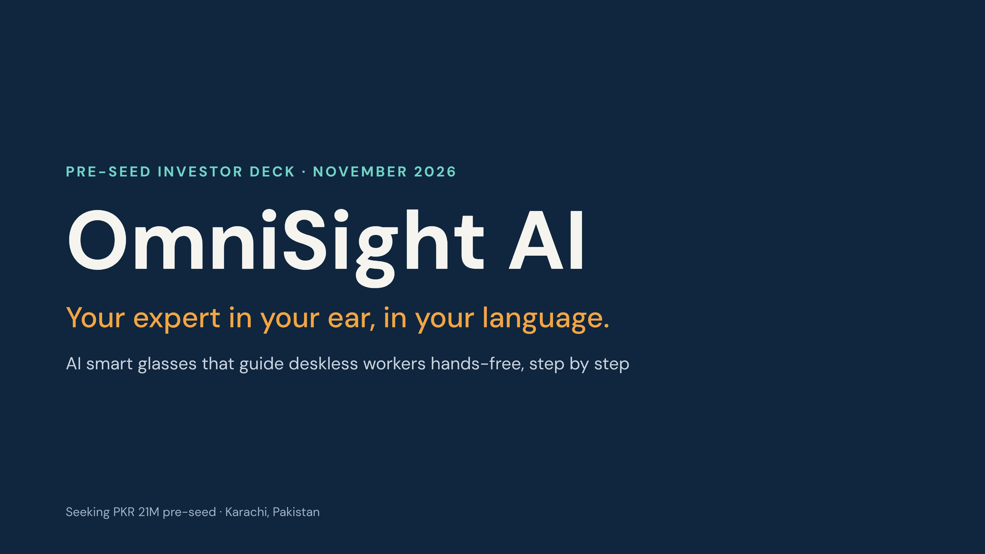
Notes:
OmniSight AI is a pair of smart glasses with a camera and microphone, connected to a back-end AI system that sees what the worker sees and guides them by voice. Target users are deskless workers: mechanics, electricians, factory operators and engineers. All numbers are planning assumptions from the 12-step execution plan and are validated in the first 30 days.

Slide 2
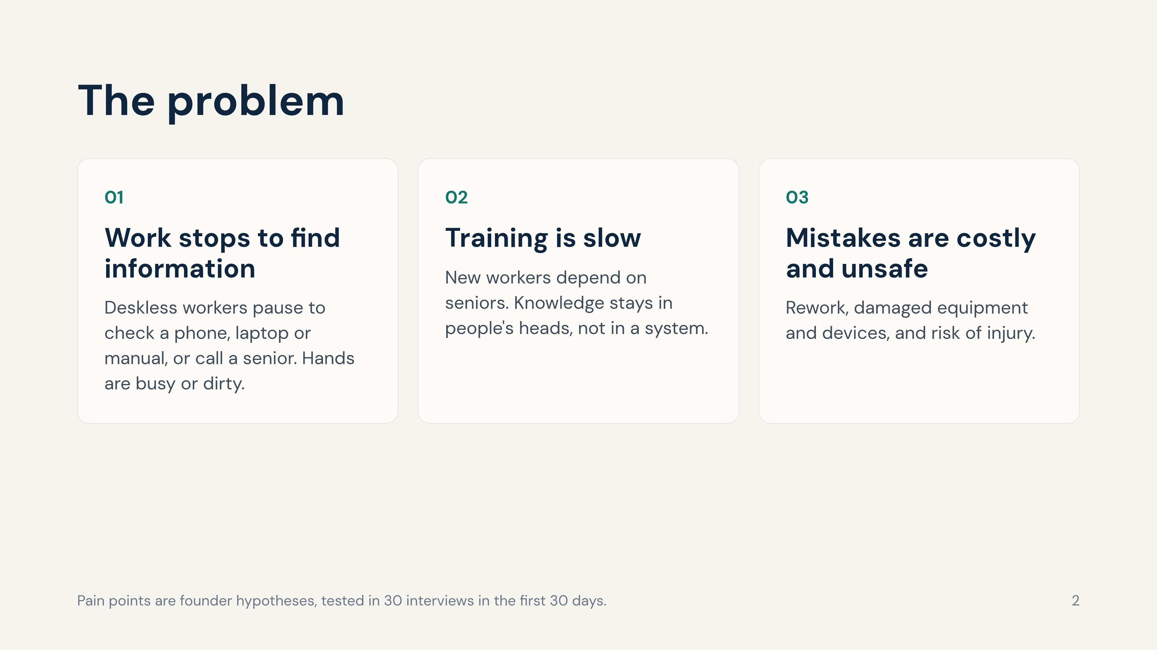
Notes:
Deskless workers: mechanics, electricians, factory operators, engineers. The split of how time is lost is a hypothesis to be replaced by interview findings.

Slide 3
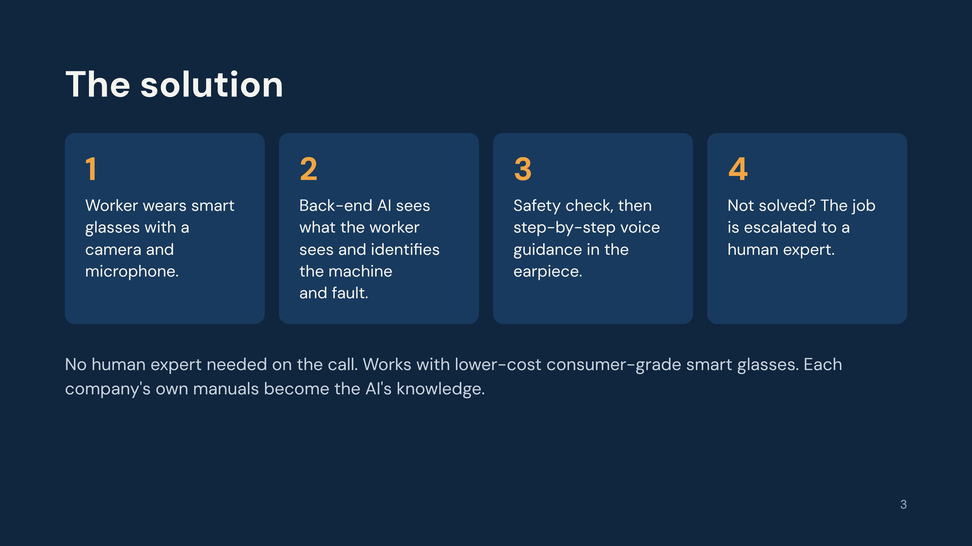
Notes:
Walk through the user journey. Emphasise the difference from existing AR tools: they usually put a human expert on the other end of a video call. Our back-end AI guides the worker on its own and only escalates when unsure. Access to glasses software platforms must be verified; the product is designed to be hardware-agnostic.

Slide 4
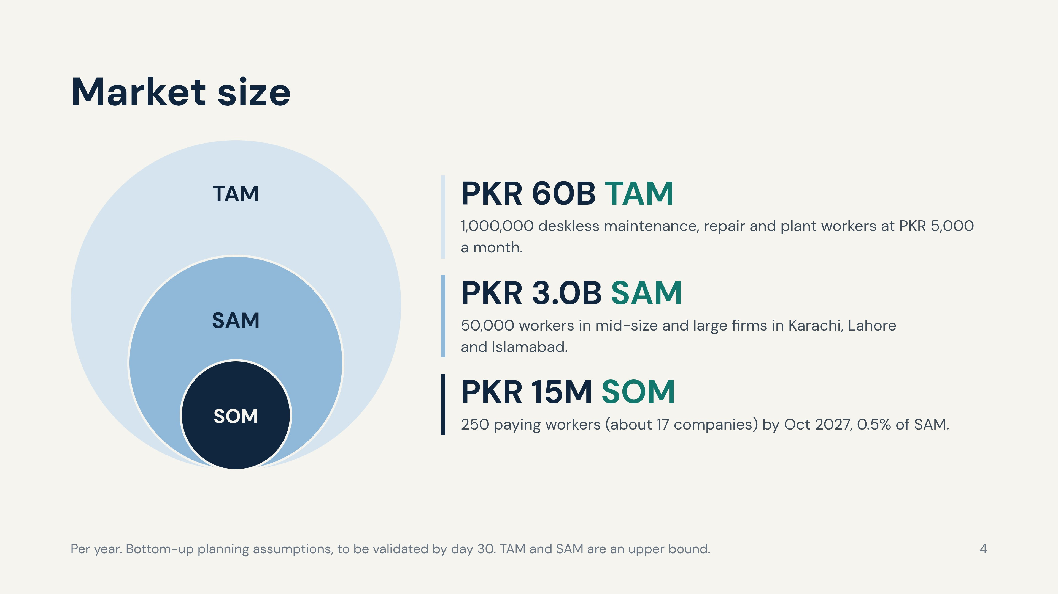
Notes:
The 1,000,000 worker figure is an assumption that must be checked against labour force data and company interviews. Circles are nested for clarity, not drawn to scale. SOM, not TAM, drives the financial model.

Slide 5
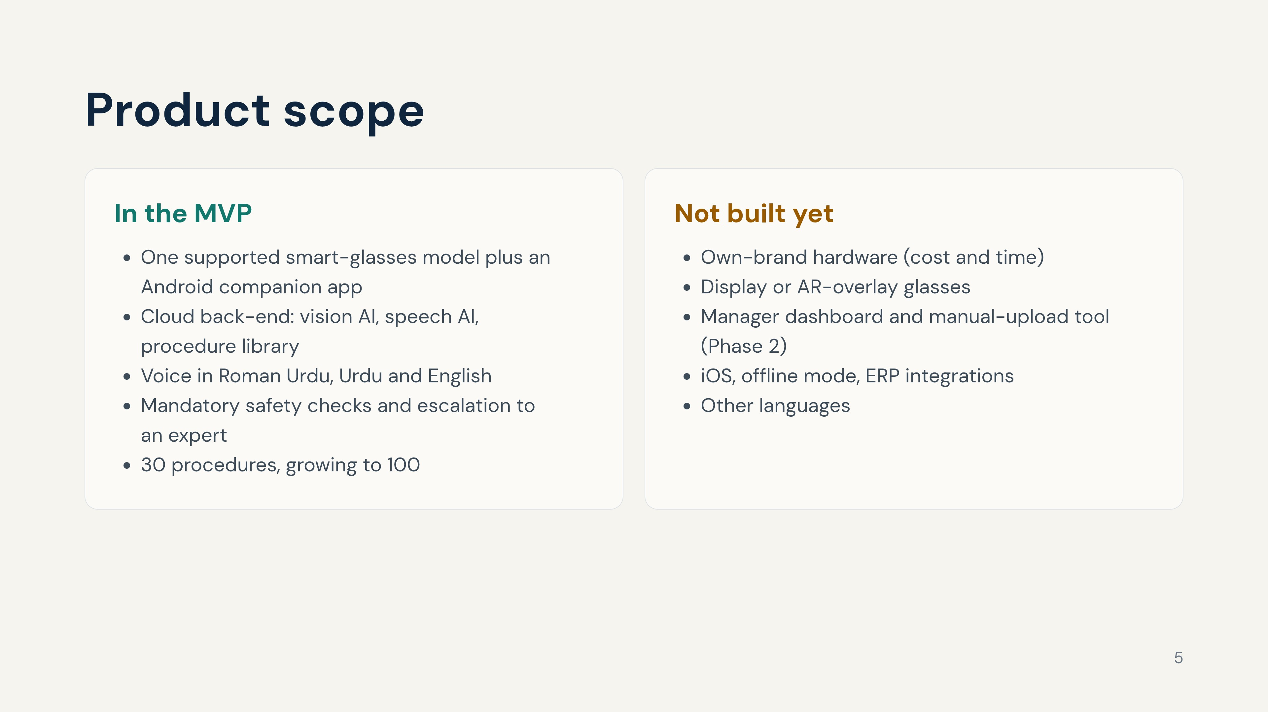
Notes:
Phase 0 (Nov 2026 to Jan 2027) builds the prototype on glasses. A 20 to 40 worker pilot with 5 companies runs in February and March 2027, and the paid launch in Karachi is April 2027. All heavy AI runs in the back-end, so the glasses stay light and low-cost.

Slide 6
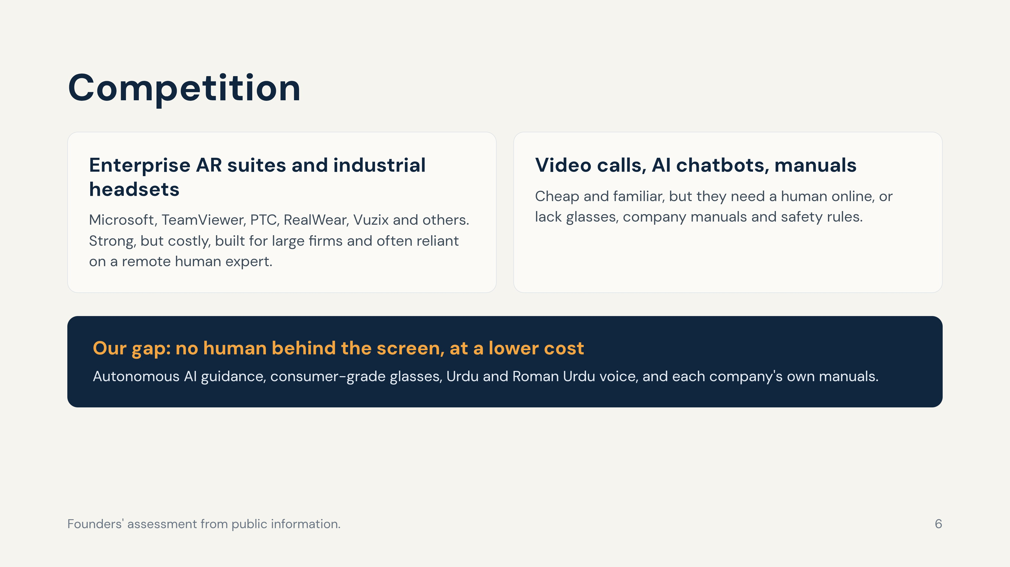
Notes:
Do not claim the idea is new. AR remote assistance already exists. Our difference is autonomy (no human expert on the call), price and local language. Consumer AI glasses makers can be both partners and future competitors; developer access to their platforms must be verified. Re-verify every competitor's current offering and pricing before investor meetings.

Slide 7
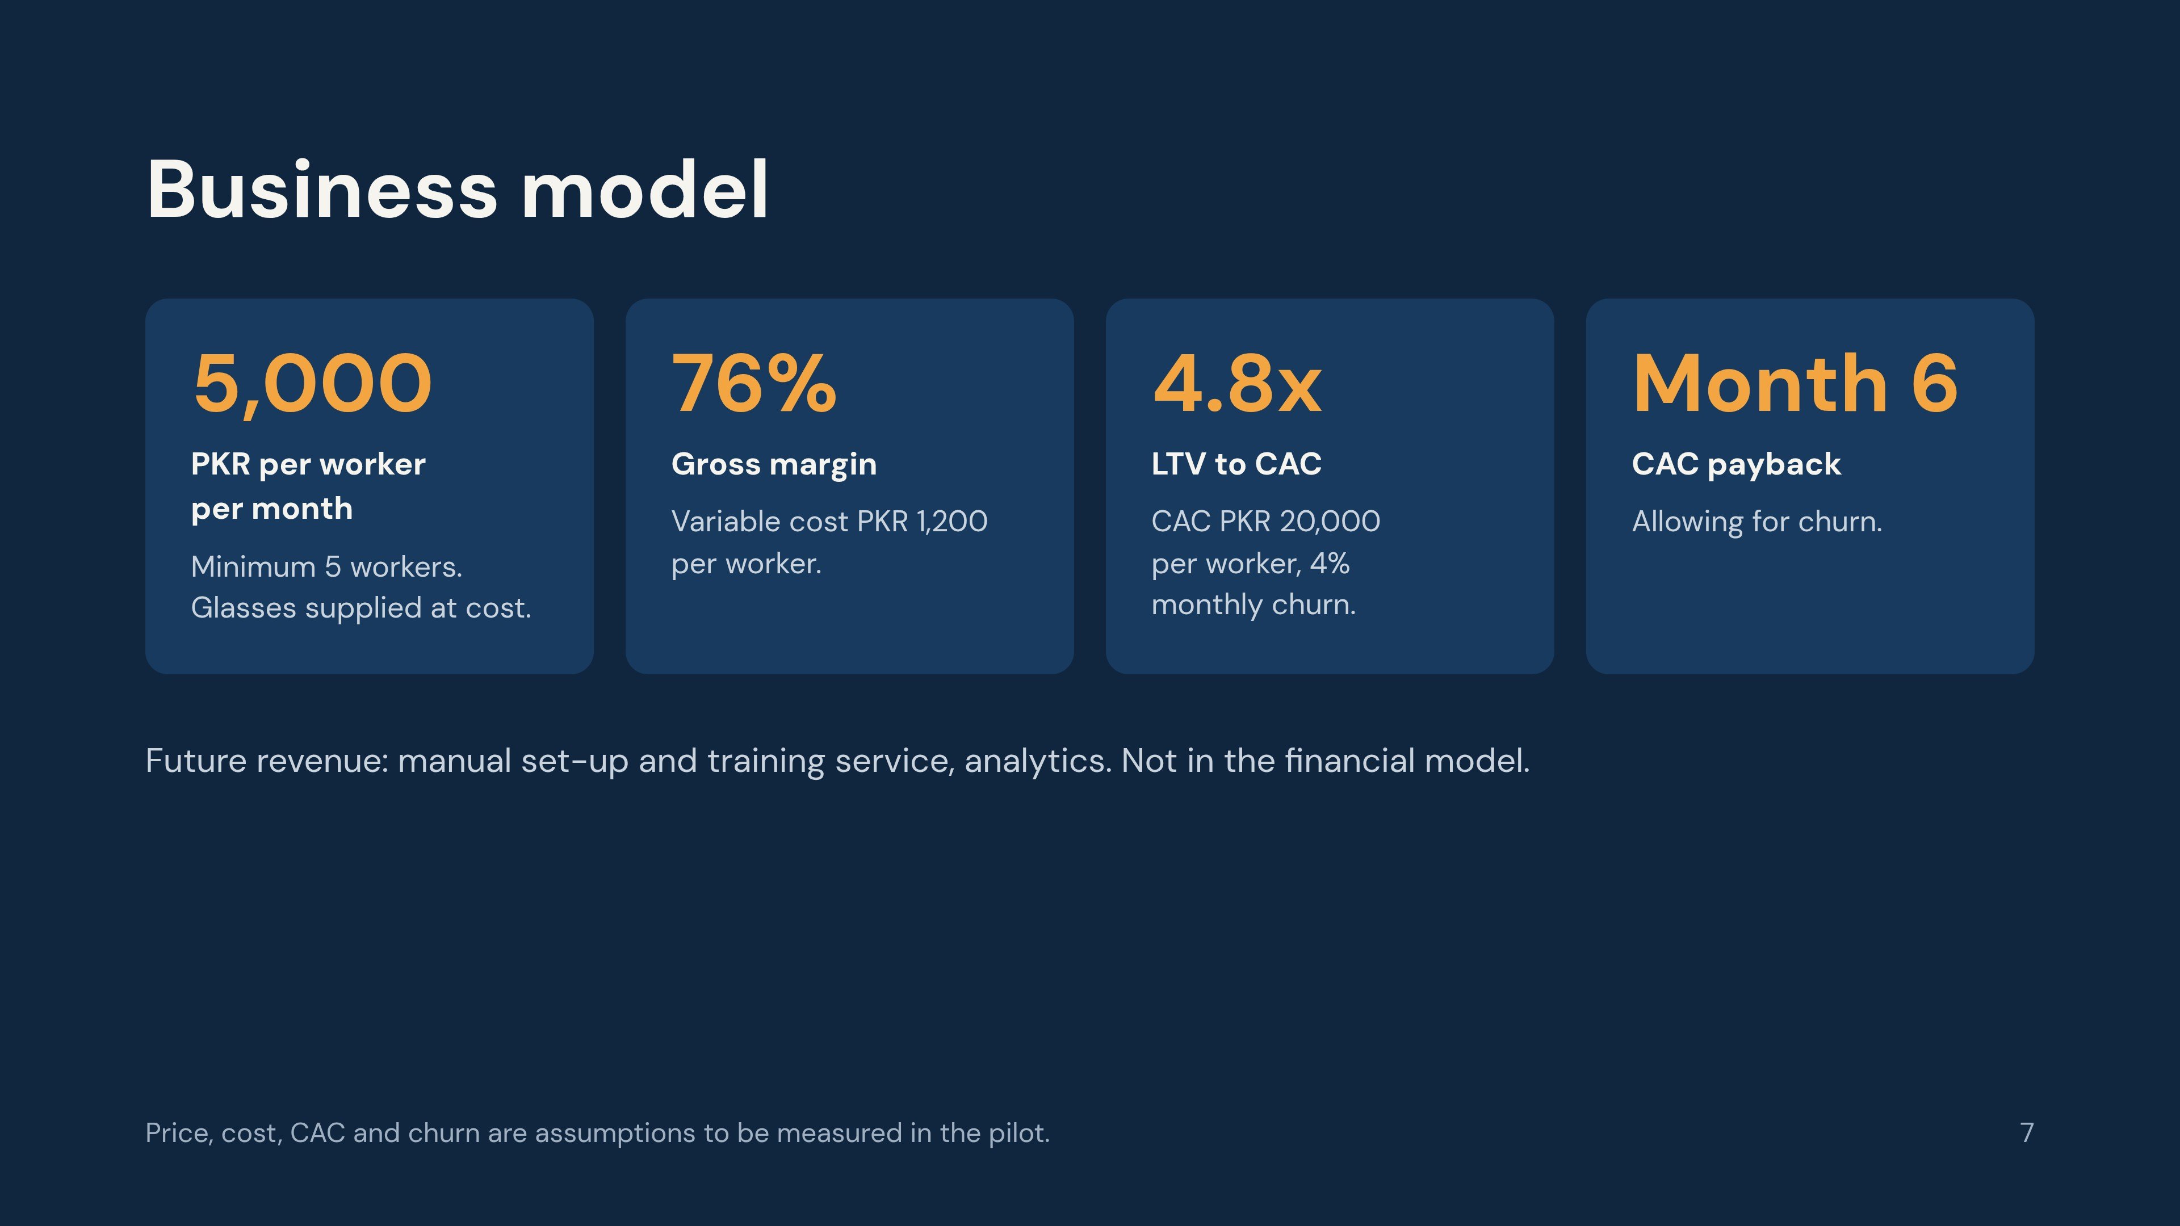
Notes:
CAC is PKR 300,000 per company with about 15 workers each. Customers buy glasses at cost through a supplier, so we hold no stock and take no hardware margin. Churn, CAC and variable cost are the least certain inputs; the financial plan shows break-even and funding need if each is worse than planned.

Slide 8
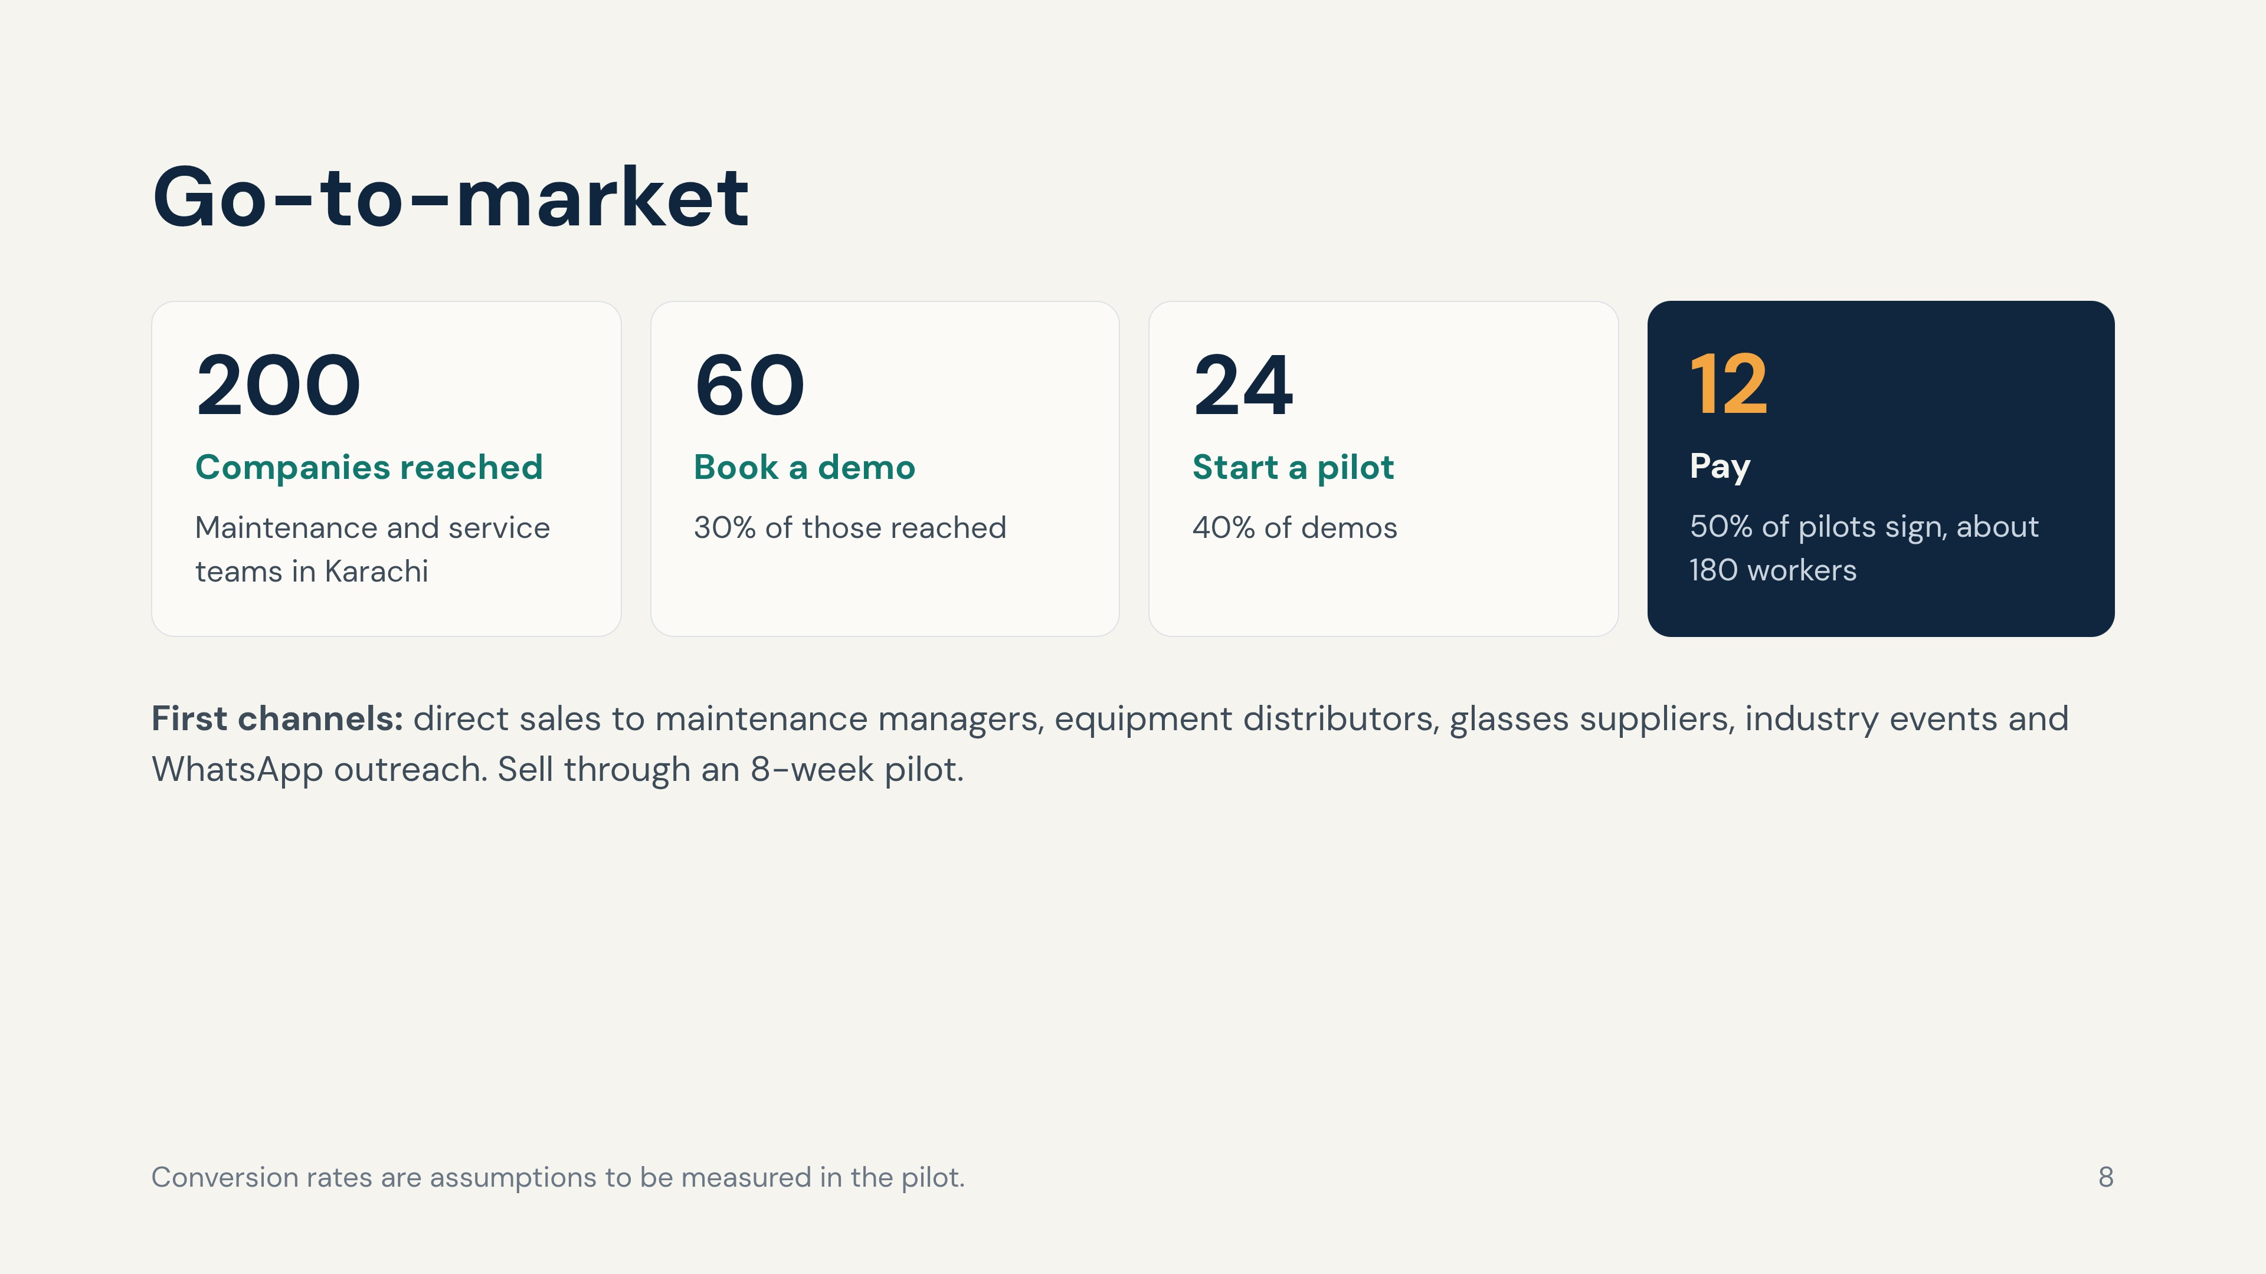
Notes:
This is business-to-business: we sell to companies, not individuals. The pilot success test is at least 80% of guided jobs rated solved and at least 50% of pilot companies signing a paid plan.

Slide 9
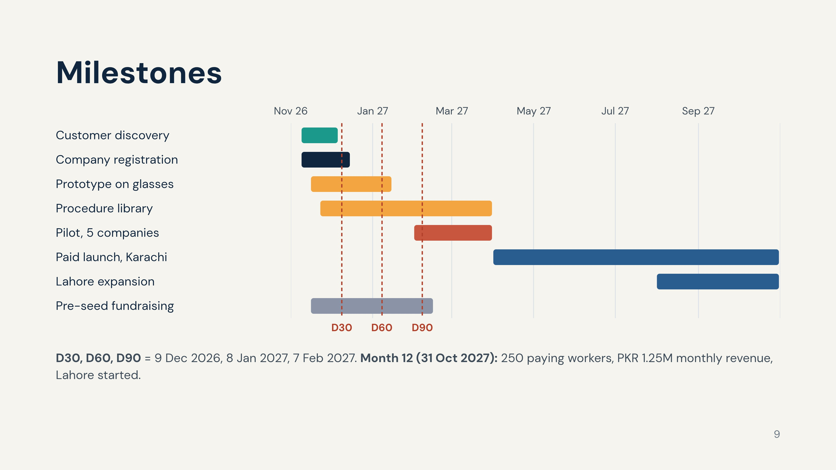
Notes:
Day counts start on Monday 9 November 2026. Day 30: 30 interviews done, industries and price confirmed, company filed, first prototype demo. Day 60: prototype running on smart glasses, 30 procedures, 3 pilot letters signed. Day 90: pilot starts with 20 workers. Pilot runs February and March 2027; paid launch April 2027.

Slide 10
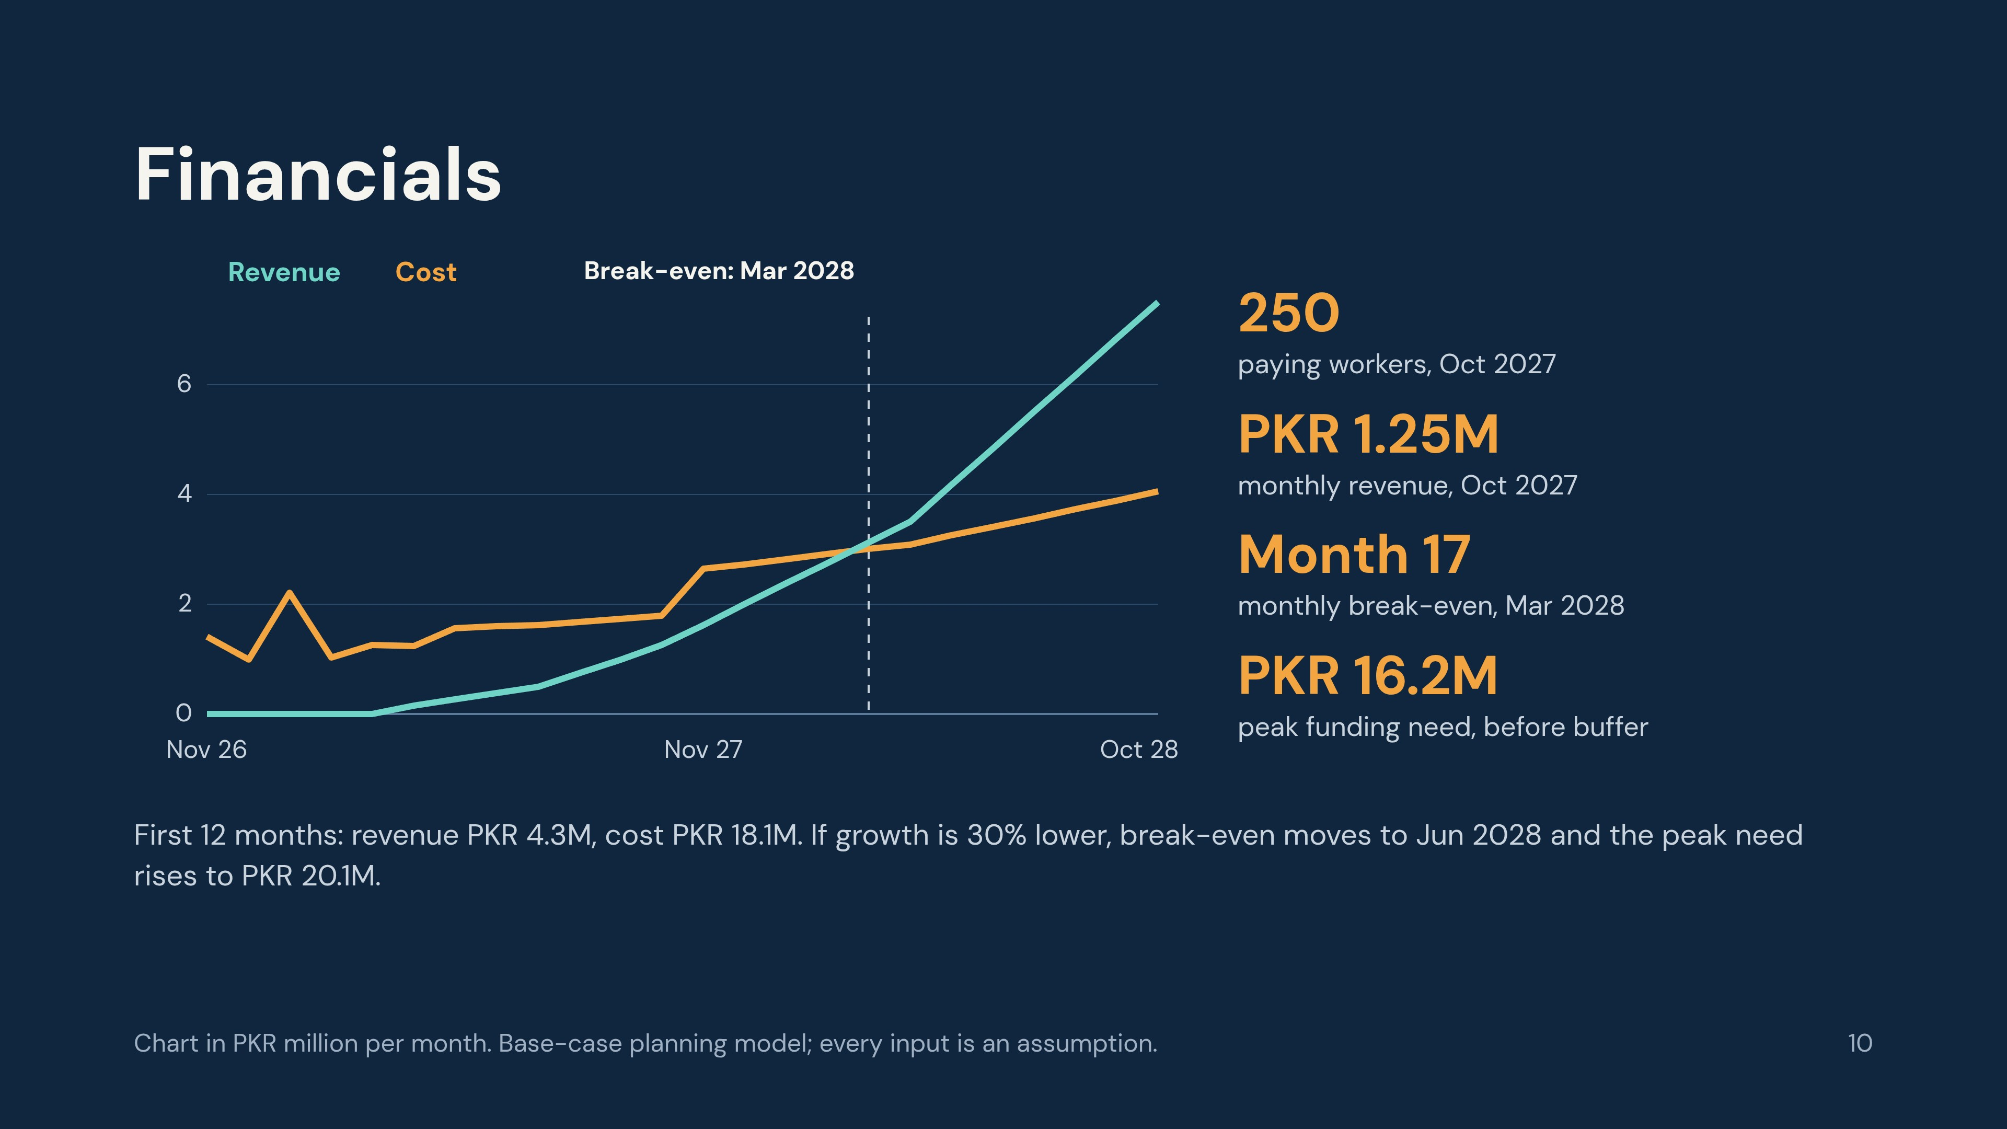
Notes:
Revenue overtakes cost in month 17 (March 2028). The jump in cost in November 2027 is the planned team growth. The spike in January 2027 is the one-off purchase of 20 pilot glasses kits. Be open about the downside: lower price, lower growth, higher variable cost or a three-month delay push break-even to May or June 2028, and a three-month delay needs about PKR 22.9M before buffer, above the ask. The plan lists cost-cut options and a possible bridge round.

Slide 11
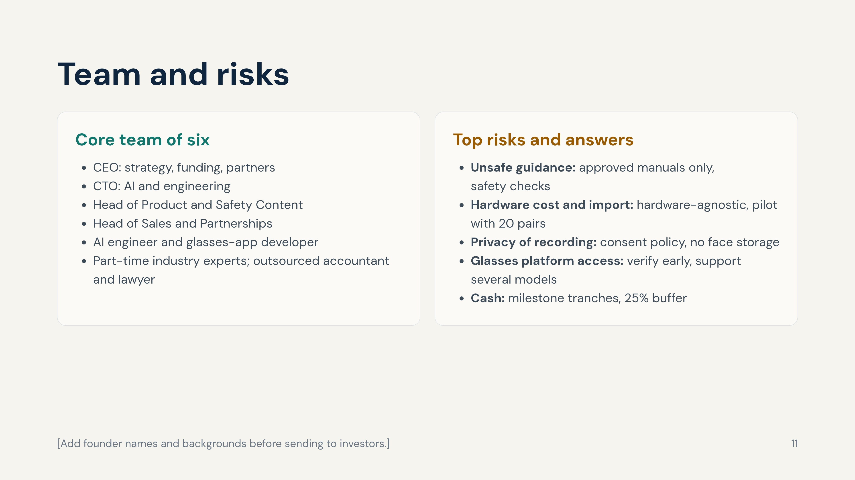
Notes:
Replace the role titles with founder names, experience and a one-line proof point each. Legal and compliance items (SECP, FBR, provincial tax, customs and device approval, privacy) are confirmed with a lawyer, tax adviser and customs broker before launch.

Slide 12
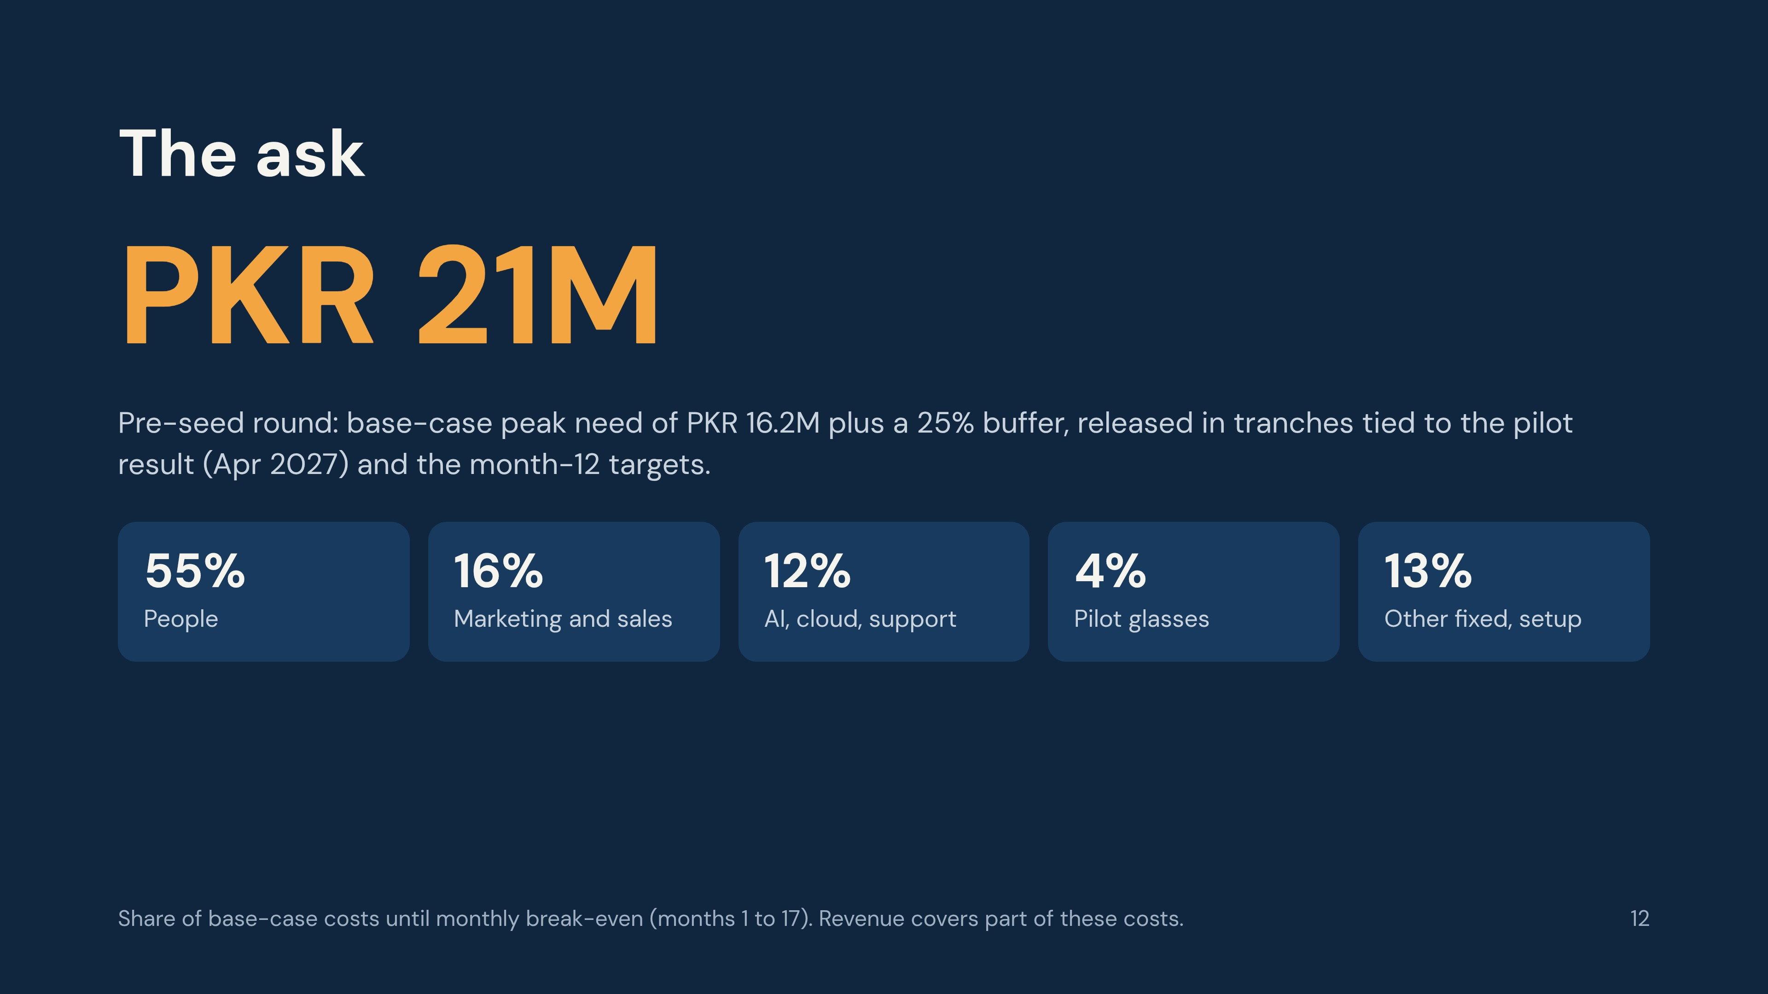
Notes:
The ask is derived from the financial model. State clearly what each tranche unlocks: the pilot success test (at least 80% of guided jobs solved, at least 50% of pilot companies willing to pay) and the month-12 target of 250 paying workers.

